Slide 1
COURSE PROJECT PHASE -1
SMART ATTENDENCE MANAGEMENT SYSTEM
TEAM MEMBERS,
SHRUTHANA - AF04975991
PALLAVI M - AF04975951

Slide 2
CONTENTS
  INTRODUCTION
  OBJECTIVES
  SYSTEM ARCHITECTURE
  TECHNOLOGIES USED
  IMPLEMENTATION
  RESULT & OUTPUT
  CONCLUSION & FUTURE SCOPE

Slide 3
INTRODUCTION
Problem Statement:
Managing attendance manually is time-consuming and prone to errors. The need for a digital, automated system to manage and update student attendance efficiently.
Aim:
To create a simple and reliable application to handle attendance digitally using Java and MySQL.

Slide 4
OBJECTIVES
  To automate attendance tracking of students.
  To store, update, and retrieve attendance records securely.
  To calculate attendance percentage automatically.
  To provide features like adding, editing, deleting, and marking attendance.
  Students can view their attendance

Slide 5
SYSTEM ARCHITECTURE
  HTML,CSS,JS→ Frontend
  JDBC → Middleware for Database Connectivity
  MySQL → Backend Database
  Flow: User Input → Database Operation → Display Result

Slide 6
TECHNOLOGIES USED
  Frontend: HTML,CSS,JAVASCRIPT
  Backend: MySQL
  Connector: JDBC
  Driver IDE: Visual Studio Code
  Programming Language: Java

Slide 7
IMPLEMENTATION
Description of major modules:
  Add Student
  View Students
  Mark Attendance
  Delete Student
  Student Viewing their attendance

Slide 8
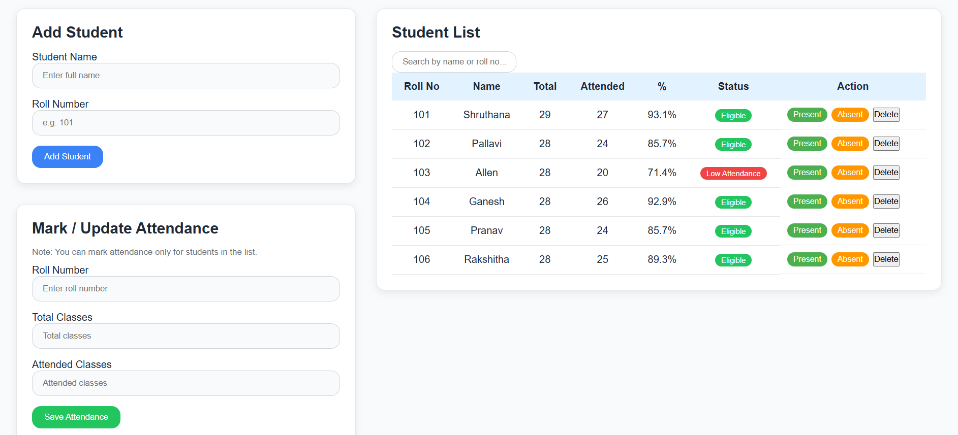
RESULTS AND OUTPUT

Slide 9
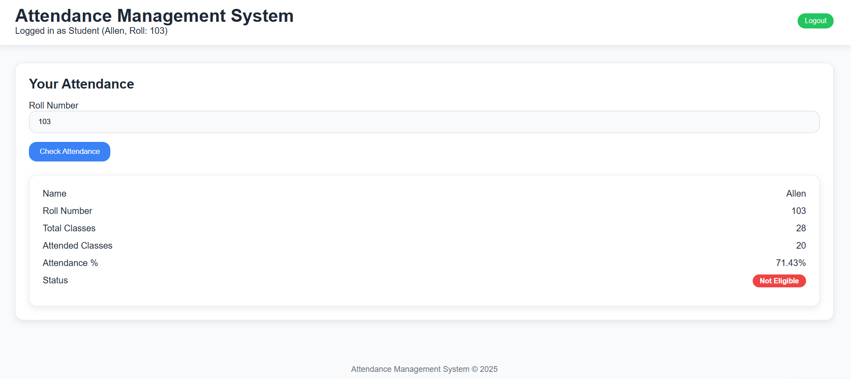

Slide 10
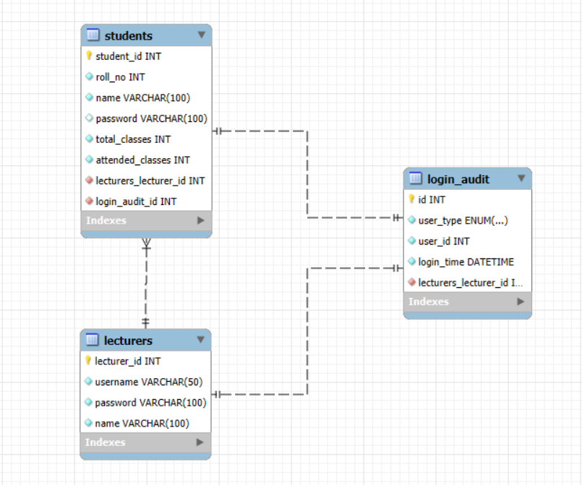

Slide 11
CONCLUSION AND FUTURE SCOPE
Conclusion:
The system successfully automates attendance management using Java and MySQL.
Future Scope:
  Integrate face recognition for automatic attendance.
  Enable cloud database for multi-device access.
  Add teacher login and reporting modules.

